Slide 1
Lecture Title: Introduction & Preliminary Discussions on Algorithms
Course Code: CSC 2211
Course Title: Algorithms
Dept. of Computer Science
Faculty of Science and Technology
Lecture No: | 01 | Week No: | 01 | Semester:
Lecturer: | Name & email: supta Richard Philip, richard@aiub.edu

Slide 2
Lecture Outline
Vision, Mission, Goal, Objective
Definitions
Computational Problems, Analysis, Design, and importance of Algorithms
Space & Time Complexity as parameters of performance for Algorithms including Asymptotic notations and
Preliminary data structure review

Slide 3
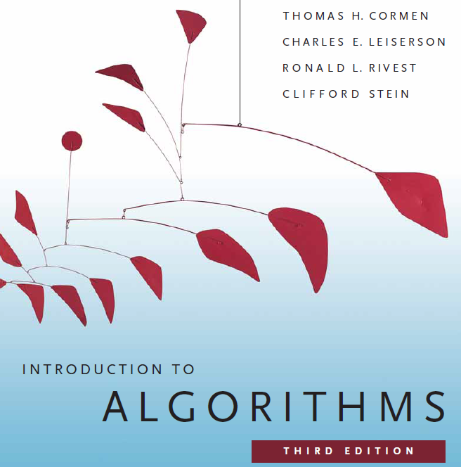

Slide 4
??????
What will we do/learn in this course?

Slide 5
The Goals of this Course
To think algorithmically
To understand and learn the idea behind algorithm design techniques
To get to know a toolbox of classical algorithms.
To reason (in a precise and formal way) about the efficiency and the correctness of algorithms.

Slide 6
I would request all of you to...
Be simple and precise in understanding the problem
Solve the problem first on the paper and then keyed in on the computer.
During lectures:
Interaction is welcome; ask questions.
Additional explanations and examples if desired.
Speed up/slow down the progress.

Slide 7
??????
What is Algorithm?

Slide 8
Informally
takes some value or set of values as input
produces some value or set of values, as output
Algorithm: any well-defined computational procedure
An algorithm is thus a sequence of computational steps that transform the input into the output.
Solving a given problem:
Data structure: Organization of data to solve the problem at hand.
Algorithm: Outline, the essence of a computational procedure, step-by-step instructions.
Program: Implementation of an algorithm in some programming language.

Slide 9
Kinds of Problem to be solved
Sorting and Searching are the basic and most common computational problem.
Clever algorithms are employed for the Internet
to manage large volume of data transfer.
Finding good routes on which the data will travel.
Search engine to quickly find requested pages.
Etc…
Numerical algorithms and number theory are employed in electronic commerce to keep and secure information such as credit card numbers, passwords, and bank statements.

Slide 10
Kinds of Problem to be solved
Allocating scarce resources in the most beneficial way.
An oil company may wish to know where to place its wells in order to maximize its expected profit.
A candidate may want to determine where to spend money buying campaign advertising in order to maximize the chances of winning at election.
An airline may wish to assign crews to flight in the least expensive way possible, making sure that each flight is covered and that government policy regarding crew policies are met.
Etc…

Slide 11
Algorithmic problem
Specification of output as a function of input
Specification of input
Algorithm
Finite number of input instances satisfying the specification.
For example:
A sorted, non-decreasing sequence of natural numbers. The sequence is of non-zero, finite length:
1, 20, 908, 909, 100000, 1000000000.
3.

Slide 12
Algorithmic Solution
Input instance, adhering to the specification
Output related to the input as required
Algorithm
Algorithm describes actions on the input instance.
There may be many correct algorithms for the same algorithmic problem.
Introduction→12

Slide 13
Definition of an Algorithm
An algorithm is a sequence of unambiguous instructions for solving a problem, i.e., for obtaining a required output for any legitimate input in a finite amount of time.
Properties:
Precision
Determinism
Finiteness
Efficiency
Correctness
Generality

Slide 14
Overall Picture
Using a computer to help solve
problems.
Precisely specify the problem.
Designing programs
Architecture → data structure
Technique → algorithms
Writing programs
Verifying (testing) programs
Data Structure and Algorithm Design Goals
Correctness
Efficiency
Implementation Goals
Adaptability
Reusability
Robustness

Slide 15
How to Develop an Algorithm?
Precisely define the problem.
Precisely specify the input and output.
Consider all cases.
Come up with a simple plan to solve the problem at hand.
The plan is language independent.
The precise problem specification influences the plan.
Turn the plan into an implementation
The problem representation (data structure) influences the implementation.

Slide 16
??????
Suppose computers were infinitely fast and computer memory was free. Would you have any reason to study algorithms?

Slide 17
Algorithm
Analysis

Slide 18
Analysis of Algorithms
Efficiency:
Running time
Space used
Efficiency as a function of the input size:
Number of data elements (numbers, points).
The number of bits of an input number .

Slide 19
The RAM Model
RAM model represents a “generic” implementation of the algorithm
Each “simple” operation (+, -, =, if, call) takes exactly 1 step.
Loops and subroutine calls are not simple operations, but depend upon the size of the data and the contents of a subroutine. We do not want “sort” to be a single step operation.
Each memory access takes exactly 1 step.
Notes:
Basically, any basic operation that takes a small, fixed amount of time we assume to take just one step.
We measure the run time of an algorithm by counting the number of steps it takes.
Why does this work? For the same reason that the “Flat Earth” model works. In our day-to-day lives we assume the Earth to be flat!
Now, lets look at how we can use this.

Slide 20
The RAM model (cntd..)
It is important to choose the level of detail.
The RAM model:
Instructions (each taking constant time), we usually choose one type of instruction as a characteristic operation that is counted:
Arithmetic (add, subtract, multiply, etc.)
Data movement (assign)
Control flow (branch, subroutine call, return)
Comparison (logical ops)
Data types – integers, characters, and floats

Slide 21
Example
Algorithm arrayMax(A, n)
# operations
currentMax ← A[0] 2
for (i =1; i<n; i++) 2n
(i=1 once, i<n n times, i++ (n-1) times)
if A[i] > currentMax then 2(n − 1)
currentMax ← A[i] 2(n − 1)
return currentMax 1
Total 6n −1

Slide 22
Example: N-by-N matrix, N-by-1 vector, multiply
Y = zeros(N,1);
for i=1:N
Y(i) = 0.0;
for j=1:N
Y(i) = Y(i) + A(i,j)*x(j);
end
end
(3 accesses, 1 add, 1 multiply)
initialize space, c₁N
initialize “for” loop, c₂N
Scalar assignment, c₃
initialize “for” loop, c₂N
c₄
N times
N times
End of loop, return/exit, c₅
End of loop, return/exit, c₅
Total = c₁N+c₂N+N(c₃+c₂N+N(c₄+c₅)+c₅)
= (c₂+c₄+c₅)N² + (c₁+c₂+c₃+c₅)N
= c₆N² + c₇N

Slide 23
Time complexity familiar tasks
Task
Matrix/vector multiply
Getting a specific element from a list
Dividing a list in half, dividing one halve in half, etc
Binary Search
Scanning (brute force search) a list
Nested for loops (k levels)
MergeSort
BubbleSort
Generate all subsets of a set of data
Generate all permutations of a set of data
Growth rate
O(N²)
O(1)
O(log₂N)
O(log₂N)
O(N)
O(N^{k})
O(N log₂N)
O(N²)
O(2^{N})
O(N!)

Slide 24
Insertion Sort
while some elements unsorted:
Using linear search, find the location in the sorted portion where the 1st element of the unsorted portion should be inserted
Move all the elements after the insertion location up one position to make space for the new element
45
38
60
45
66
60
45
66
79
47
13
74
36
21
94
22
57
16
29
81
the fourth iteration of this loop is shown here

Slide 25
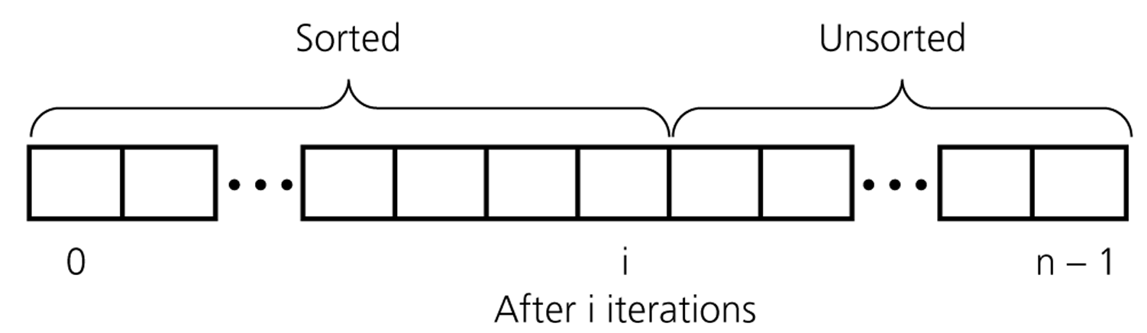
An insertion sort partitions the array into two regions

Slide 26
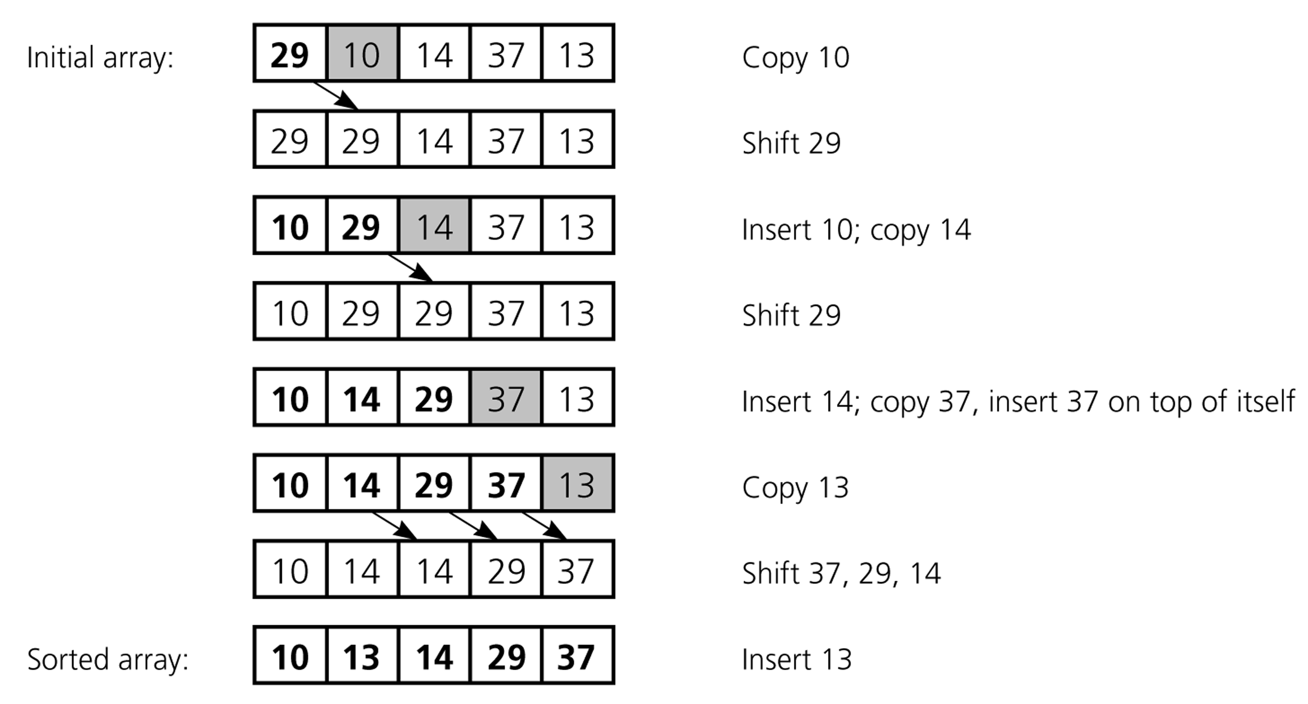
An insertion sort of an array of five integers

Slide 27
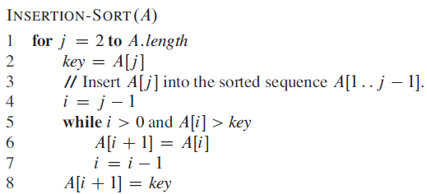
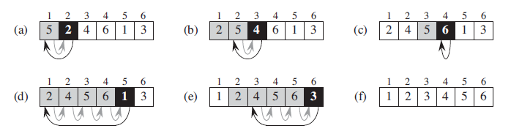
Insertion Sort

Slide 28
Loop invariants and the correctness of insertion sort
Loop Invariant: is a property of a program loop that is true before (and after) each iteration.
Initialization: It is true prior to the first iteration of the loop.
Maintenance: If it is true before an iteration of the loop, it remains true before the next iteration.
Termination: When the loop terminates, the invariant gives us a useful property that helps show that the algorithm is correct.

Slide 29
Analysis of Insertion Sort
Time to compute the running time as a function of the input size (exact analysis).
for j := 2 to n do
key := A[j]
// Insert A[j] into A[1..j-1]
i := j-1
while i>0 and A[i]>key do
A[i+1]:=A[i]
i--
A[i+1]:=key
cost c₁
c₂
0
c₃
c₄
c₅
c₆
c₇
times n n-1 n-1 n-1 n-1

Slide 30
…Analysis of Insertion Sort
The running time of an algorithm is the sum of the running times of each statement.
A statement with cost c that is executed n times contributes c*n to the running time.
The total running time T(n) of insertion sort is
T(n)= c₁*n + c₂(n-1) + c₃(n-1) + c₄ + c₅ + c₆
+ c₇ (n-1)

Slide 31
…Analysis of Insertion Sort
Often the performance depends on the details of the input (not only the length n).
This is modeled by t_{j.}
In the case of insertion sort the time t_{j} depends on the original sorting of the input array.

Slide 32
Performance Analysis
Performance often draws the line between what is feasible and what is impossible.
Often it is sufficient to count the number of iterations of the core (innermost) part.
No distinction between comparisons, assignments, etc (that means roughly the same cost for all of them).
Gives precise enough results.
In some cases the cost of selected operations dominates all other costs.
Disk I/O versus RAM operations.
Database systems.

Slide 33
Best/ Worst/ Average Case
Best case: works fast on some input.
Worst case: (usually) maximum time of algorithm on any input of size.
Average case: (sometimes) expected time of algorithm over all inputs of size. Need assumption of statistical distribution of inputs.
Analyzing insertion sort’s
Best case: elements already sorted, t_{j}=1, running time ≈ (n-1), i.e., linear time.
Worst case: elements are sorted in inverse order, t_{j} = j-1, running time ≈ (n²-n)/2 , i.e., quadratic time.
Average case: t_{j} = j / 2, running time ≈ (n²+n-2)/4 , i.e., quadratic time.

Slide 34
…Best/ Worst/ Average Case
For inputs of all sizes:
worst-case
6n
average-case
5n
best-case
Running time
4n
3n
2n
1n
1 2 3 4 5 6 7 8 9 10 11 12 …..
Input instance size

Slide 35
…Best/ Worst/ Average Case
Worst case is usually used:
It is an upper-bound.
In certain application domains (e.g., air traffic control, surgery) knowing the worst-case time complexity is of crucial importance.
For some algorithms worst case occurs fairly often
The average case is often as bad as the worst case.
Finding the average case can be very difficult.

Slide 36
Asymptotic Notation
Asymptotic Notations are languages that allow us to analyze an algorithm's running time by identifying its behavior as the input size for the algorithm increases.
This is also known as an algorithm's growth rate.(Wiki)

Slide 37
Asymptotic Notation
The “big-Oh” O-Notation
asymptotic upper bound
f(n) = O(g(n)), if there exists constants c>0 and n₀>0, s.t. f(n) ≤ c g(n) for n ≥ n₀
f(n) and g(n) are functions
over non- negative integers
Used for worst-case analysis
Running Time
Input Size

Slide 38
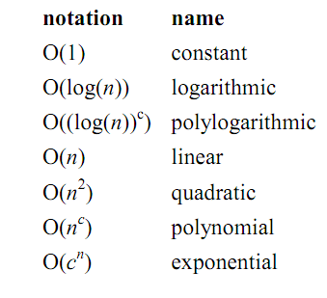
Asymptotic Notation

Slide 39
...Asymptotic Notation
The “big-Omega” Ω−Notation
asymptotic lower bound
f(n) = Ω(g(n)) if there exists constants c>0 and n₀>0, s.t. c g(n) ≤ f(n) for n ≥ n₀
Used to describe best-case running times or lower bounds of algorithmic problems.
E.g., lower-bound of searching in an unsorted array is Ω(n).
Running Time
Input Size

Slide 40
...Asymptotic Notation
The “big-Theta” Θ−Notation
asymptoticly tight bound
f(n) = Θ(g(n)) if there exists constants c₁>0, c₂>0, and n₀>0, s.t. for n ≥ n₀ c₁ g(n) ≤ f(n) ≤ c₂ g(n)
f(n) = Θ(g(n)) if and only if f(n) = Ο(g(n)), f(n) = Ω(g(n))
O(f(n)) is often abused instead of Θ(f(n))
Running Time
Input Size

Slide 41
Asymptotic Analysis
Goal: to simplify the analysis of the running time by getting rid of details, which are affected by specific implementation and hardware
rounding of numbers: 1,000,001 ≈ 1,000,000
rounding of functions: 3n² ≈ n²
Capturing the essence: how the running time of an algorithm increases with the size of the input in the limit.
Asymptotically more efficient algorithms are best for all but small inputs

Slide 42
...Asymptotic Analysis
Simple Rule: Drop lower order terms and constant factors.
50 n log n is O(n log n)
7n - 3 is O(n)
8n² log n + 5n² + n is O(n² log n)
Note: Although (50 n log n) is O(n⁵), it is expected that an approximation is of the smallest possible order.

Slide 43
Correctness of Algorithms
An algorithm is correct if for any legal input it terminates and produces the desired output.
Automatic proof of correctness is not possible (so far).
There are practical techniques and rigorous formalisms that help to reason about the correctness of (parts of) algorithms.

Slide 44
Partial and Total Correctness
Partial correctness
IF this point is reached,
THEN this is the desired output
Any legal input
Algorithm
Output
Total correctness
INDEED this point is reached,
AND this is the desired output
Any legal input
Algorithm
Output

Slide 45
Assertions
To prove partial correctness we associate a number of assertions (statements about the state of the execution) with specific checkpoints in the algorithm.
E.g., A[1], …, A[ j ] form an increasing sequence
Preconditions – assertions that must be valid before the execution of an algorithm or a subroutine (INPUT).
Postconditions – assertions that must be valid after the execution of an algorithm or a subroutine (OUTPUT).

Slide 46
Pre/post-conditions
Example:
Write a pseudocode algorithm to find the two smallest numbers in a sequence of numbers (given as an array).
INPUT: an array of integers A[1..n], n > 0
OUTPUT: (m1, m2) such that
m1<m2 and for each i∈[1..n]: m1 ≤ A[i] and, if A[i] ≠ m1, then m2 ≤ A[i].
m2 = m1 = A[1] if ∀j,i∈[1..n]: A[i]=A[j]

Slide 47
Loop Invariants
Invariants: assertions that are valid any time they are reached (many times during the execution of an algorithm, e.g., in loops)
We must show three things about loop invariants:
Initialization: it is true prior to the first iteration.
Maintenance: if it is true before an iteration, then it is true after the iteration.
Termination: when a loop terminates the invariant gives a useful property to show the correctness of the algorithm

Slide 48
Example: Binary Search
l := 1
r := n
do
m := ⎣(l+r)/2⎦
if A[m] = q then return m
else if A[m] > q then r := m-1
else l := m+1
while l <= r
return NIL
We want to show that q is not in A if NIL is returned.
Invariant: ∀i∈[1..l-1]: A[i]<q (Ia)
∀i∈[r+1..n]: A[i]>q (Ib)
Initialization: l = 1, r = n the invariant holds because there are no elements to the left of l or to the right of r.
l=1 yields ∀j,i ∈[1..0]: A[i]<q this holds because [1..0] is empty
r=n yields ∀j,i ∈[n+1..n]: A[i]>q this holds because [n+1..n] is empty

Slide 49
…Example: Binary Search
l := 1
r := n
do
m := ⎣(l+r)/2⎦
if A[m] = q then return m
else if A[m] > q then r := m-1
else l := m+1
while l <= r
return NIL
Invariant: ∀i∈[1..l-1]: A[i]<q (Ia) ∀i∈[r+1..n]: A[i]>q (Ib)
Maintenance: l, r, m = ⎣(l+r)/2⎦
A[m]!=q & A[m]>q, r=m-1, A sorted implies ∀k∈[r+1..n]: A[k]>q (Ib)
A[m]!=q & A[m]<q, l=m+1, A sorted implies ∀k∈[1..l-1]: A[k]<q (Ia)

Slide 50
…Example: Binary Search
Invariant: ∀i∈[1..l-1]: A[i]<q (Ia) ∀i∈[r+1..n]: A[i]>q (Ib)
l := 1
r := n
do
m := ⎣(l+r)/2⎦
if A[m] = q then return m
else if A[m] > q then r := m-1
else l := m+1
while l <= r
return NIL
Termination: l, r, l<=r
Two cases:
l:=m+1 we get ⎣(l+r)/2⎦ +1 > l
r:=m-1 we get ⎣(l+r)/2⎦ -1 < r
The range gets smaller during each iteration and the loop will terminate when l<=r no longer holds.

Slide 51
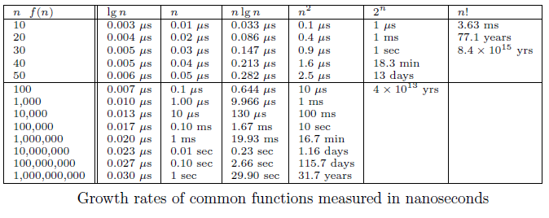
Growth Rates and Dominance Relations

Slide 52
Proof by Induction
We want to show that property P is true for all integers n ≥ n₀.
Basis: prove that P is true for n₀.
Inductive step: prove that if P is true for all k such that n₀ ≤ k ≤ n – 1 then P is also true for n.
Example
Basis

Slide 53
...Proof by Induction
Inductive Step

Slide 54
Sorting
Sorting is a classical and important algorithmic problem.
We look at sorting arrays (in contrast to files, which restrict random access).
A key constraint is the efficient management of the space
In-place sorting algorithms
The efficiency comparison is based on the number of comparisons (C) and the number of movements (M).

Slide 55
Sorting
Simple sorting methods use roughly n * n comparisons
Insertion sort
Selection sort
Bubble sort
Fast sorting methods use roughly n * log n comparisons.
Merge sort
Heap sort
Quicksort

Slide 56
References & Readings
CLRS
Chapters: 1, 2 (2.1, 2.2), 3
Exercises: 1.2-2, 1.2-3, 2.1-3, 2.1-4, 2.2-1, 2.2-3, 3.1-1, 3.1-4, 3.1-6, 3.1
Problems: 1-1, 3-3
HSR
Chapters: 1 (1.1-1.3)
Examples: 1.4-1.6, 1.11-1.13, 1.17-1.18
Exercises: 1.3 (1-4, 8, 9)
Review for laboratory
HSR
Chapters: 2, 3.2 - 3.5
CLRS
Chapters: 6, 7, 10, 12

